Slide 1
CSE7302- UNIVERSITY PROJECT
Review-2
Student Innovation: Swadeshi for Atmanirbhar Bharat - Travel & Tourism
Batch Number:ISE_09
Roll Number | Student Name
Under the Supervision of,
Dr Chandrasekar V
Professor
School of Computer Science and Engineering
Presidency University
20221ISE0021 | TANUSHREE.M.S
20221ISE0036 | DARSHAN.R.H
20221ISE0010 | MANASA L NAIK
Name of the Program: B. Tech Information Science Engineering(Robotics)
Name of the HoD: Dr. Gopal Krishna Shyam
Name of the Program Project Coordinator: Ms. Suma N G
Name of the School Project Coordinators: Dr. Sampath A K, Dr. Geetha A

Slide 2
Content
Problem Statement
Objectives
Background and Related work for title Selection
Analysis of Problem Statement
Innovation or Novel Contributions
GitHub Link
Timeline of the Project
References

Slide 3
Problem Statement Number: SIH25137
Organization: Presidency University
Category: Software
Problem Description: India has a rich cultural heritage, natural diversity, and traditional tourism experiences, yet travellers face challenges in planning optimal multi-palace trips. Current platforms don't provide AI-powered sequential route optimization that considers travel timing, accommodation availability, transport convenience, and cultural significance. There's a need for a Swadeshi AI Travel Planner that suggests the most feasible, essential, and convenient sequence for visiting multiple tourist places within India.
Expected output: Development of SwadeshiYatra – an AI-powered intelligent travel planning platform that:
~Allows tourists to select multiple cities and attractions
~Generates optimized travel sequences
~Predicts trip duration
~Recommends hotels, guides, and restaurants

Slide 4
Objectives
• Develop an AI-based route optimization model for multi-place travel planning.
• Generate optimal visiting sequences for tourist locations based on:
Travel time
attraction timing
user preferences.
• Provide personalized itinerary generation including accommodation, guides, and restaurants.
• Integrate real-world travel constraints such as peak hours, cultural timings, and transport availability.

Slide 5
Background and Related work for title Selection
Background:
Indian travellers increasingly plan multi-city trips but lack intelligent tools for optimal sequencing. Foreign platforms focus on bookings but ignore Indian-specific travel patterns - temple timings, festival schedules, monsoon disruptions, tier-2 city connectivity. A Swadeshi AI solution can provide culturally-aware, timing-optimized itineraries.
Related work:
Global platforms (Booking.com, TripAdvisor) offer basic multi-city search but no intelligent sequencing. Indian apps focus on single destinations. Research in AI Travel Route Optimization (Genetic Algorithms, Reinforcement Learning) exists but lacks India-specific implementation. Government portals promote tourism but don't offer personalized multi-place trip planning.

Slide 6
Analysis of Problem Statement (contd...)
Challenges:
• Travellers select multiple tourist places but do not know the optimal visiting order • Transport timing conflicts between places • Accommodation booking gaps between cities • Peak tourist hours cause long queues • Unplanned backtracking increases travel time and cost • Lack of intelligent tools to predict realistic trip duration
Opportunities: • Real-time APIs can provide weather, transport schedules, and event information

Slide 7
Analysis of Problem Statement (contd...)
Scope of the Solution:
The proposed system develops an AI-powered Swadeshi Travel Planner that:
• Allows tourists to select cities and attractions • Generates optimized multi-city travel routes • Predicts trip duration and travel feasibility • Suggests hotels, guides, and restaurants • Produces a complete day-wise itinerary

Slide 8
Innovation or Novel Contributions
AI Route Optimization Engine
Uses some optimization techniques to determine the best sequence of visiting places , considering travel time and user preferences.
India-Specific Travel Intelligence
Considers temple timings, festivals, seasonal conditions, and other factors.
Constraint-Based Travel Planning
The system generates an itinerary only after collecting constraints such as:
trip duration
budget
transport preference
food preference.

Slide 9
Github Link
Github Link
Repository: https://github.com/Darshan455111/SwadeshiYatra

Slide 10
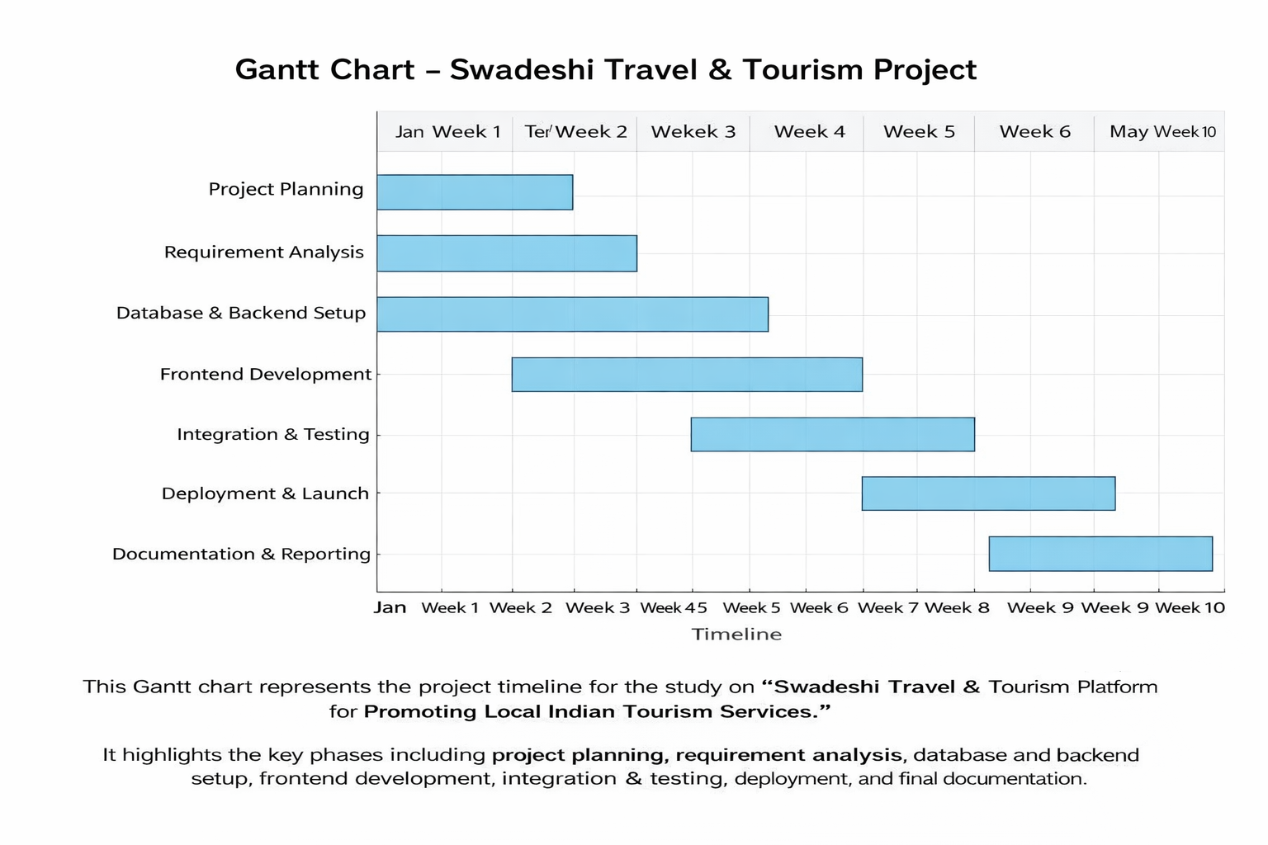
Timeline of the Project (Gantt Chart)

Slide 11
References (IEEE Paper format)
[1] S. Cao, Y. Zhang, and X. Li, “An Optimal Round-Trip Route Planning Method for Tourism Based on Genetic Algorithm,” Computational Intelligence and Neuroscience, vol. 2022, pp. 1–13, Aug. 2022.
This paper proposes a genetic algorithm–based method for optimizing tourism routes between multiple attractions. The system calculates the shortest and most efficient visiting sequence while estimating travel time and trip duration for tourists.
[2] M. Şehab, A. Al-Saffar, and M. K. Hasan, “An Enhanced Genetic Algorithm Solution for Tourist Itinerary Recommendation,” PeerJ Computer Science, 2024.
The paper proposes an improved genetic algorithm to recommend efficient tourist itineraries considering constraints such as travel time and user preferences.The algorithm improves route quality and planning efficiency for tourism applications
.
[3] S. Kumar, R. Patel, and A. Sharma, “Tour Itinerary Planner: A Genetic Algorithm and Clustering Approach,” in Proc. ACM Int. Conf. Advanced Computing Applications, 2025.
This research proposes a hybrid system combining clustering and genetic algorithms to generate multi-day travel itineraries. Each cluster represents a day’s plan, and the GA determines the optimal sequence of attractions.

Slide 12
References (IEEE Paper format)
[4] X. Jiang and L. Wang, “Application of Genetic Algorithm in Optimizing Path Selection in Tourism Route Planning,” Journal of Engineering Science Research, 2024.
The study analyzes how genetic algorithms can be applied to tourism route optimization problems. It demonstrates improved path efficiency and faster convergence when planning routes among multiple tourist destinations.
[5] A. Wibowo and D. Handayani, “A Genetic Algorithm for Generating Travel Itinerary Recommendation with Restaurant Selection,” International Journal of Intelligent Systems, 2020.
This paper presents a genetic-algorithm-based model that generates complete travel itineraries including restaurants and attractions. The system optimizes route order while considering tourist preferences and time constraints.
[6] B. Li et al., “Research on Travel Route Planning Optimization Based on Large Language Model,” 2024.
This research integrates graph search algorithms and large language models to improve travel route recommendation systems. It incorporates factors such as distance, popularity, and user preferences to generate optimized travel routes.

Slide 13
References (IEEE Paper format)
[7] Y. Wang, “Research on Travel Route Planning Problem Based on Greedy Algorithm,” arXiv Preprint, 2024.
The study proposes a greedy algorithm-based route planning system that considers attraction ratings and city evaluation metrics. It generates personalized travel routes according to tourists’ preferences.
[8] D. Liu et al., “Personalized Tour Itinerary Recommendation Algorithm Based on Multi-Objective Optimization,” Applied Sciences, vol. 14, no. 12, 2024.
This paper introduces a multi-objective itinerary recommendation algorithm that balances travel cost, time, and tourist satisfaction. It combines AI techniques with optimization algorithms to improve personalized trip planning.
[9] C. García-González et al., “A Systematic Literature Review for the Tourist Trip Design Problem,” European Transport Research Review, 2022.
This paper reviews various algorithms used in tourist trip planning systems, including genetic algorithms, optimization models, and recommender systems. It provides a taxonomy of approaches used in itinerary planning research.

Slide 14
References (IEEE Paper format)
[10] A. Bolotbekova et al., “Trip Route Optimization Based on Bus Transit Using Genetic Algorithm,” Scientific Reports, vol. 15, 2025.
This research focuses on optimizing tourist routes using genetic algorithms to minimize travel time and cost. The system improves route efficiency and allows tourists to visit more attractions within limited time

Slide 15


